Slide 1

LifeAtHere
Code 007: The Backend Experience
Anushikha Sharma, Allan La, Lucas Nicolois, & Lukas Munoz
Notes:
Introductory Slide

Slide 2

What is Code 007?
We are a group of Bucknell Students majoring in Computer Science & Engineering whose main motive is the development of LifeAtHere
Scrum Master - Peter Lucas Nicolois
Project Owner - Lukas Munoz
Developers - Anushikha Sharma, Allan La
Notes:
Everyone should introduce themselves

Slide 3
The Problem
Bucknell has events and activities going on every single day. In addition the students, faculty, staff, and visitors on Bucknell’s campus lead busy lives that require them to keep track of tons of information
Our client, Leo Botinelly at Enterprise systems, has this information and wants to consolidate it into a usable format with a web and mobile app
Our project focuses on creating the backend necessary to accomplish this task and a webapp to access that information
We will be in collaboration with the mobile team for LifeAtHere as well
Notes:
Lucas

Slide 4

Our Process
Met with Leo to discuss the scope of the problem
Used interviews and surveys to collect data to understand what different groups might need
Based on the interview results, narrowed down all the features
Chose a feature to implement within the scope of this class
Notes:
Anushikha

Slide 5
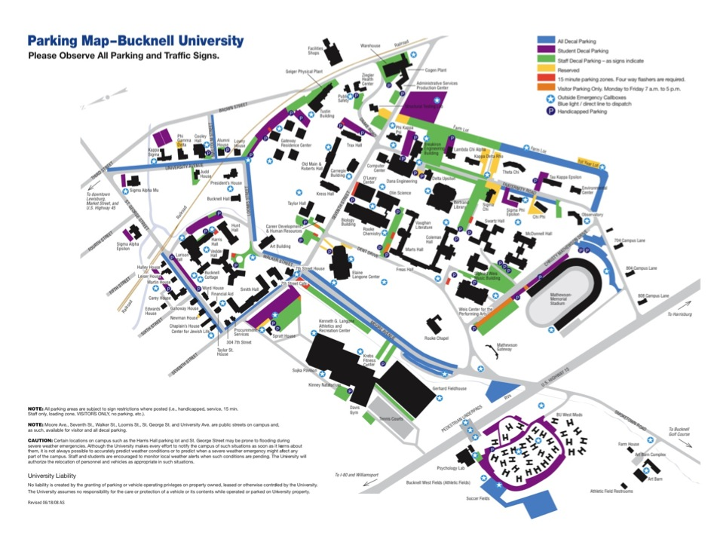
Primary Objectives
The primary goal of our client is to create a consolidated platform that caters to students, faculty, staff and visitors.
Compiled features can include:
Event Board
Navigation & Parking Assistance
Integration with existing Bucknell Sites
Visitor Information
Notes:
Allan

Slide 6
Our Three Proposed Solutions
Based on our interviews, we have following three proposed solutions -
Design for Students
Design for Faculty
Design for Visitors
We will use Bucknell servers
There already existing endpoints for Moodle and other Bucknell related features
Notes:
Lukas

Slide 7
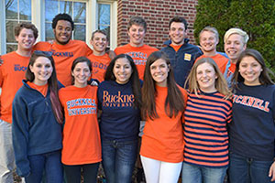
Proposed Solution 1: Students
Focus:
Main target audience are students
Sub-audience include staff, faculty, and visitors
Features:
Ability to post events on the application
Invite friends to these events and chat event hosts
Integrating Bucknell & Facebook API
Notes:
Allan

Slide 8
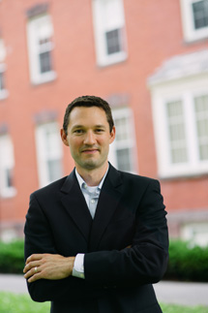
Proposed Solution 2: Faculty
Focus: Assist faculty in their daily tasks and scheduling
Features:
Integrate the application with moodle
Online Add/Drop system
One platform for scheduling (integration with Google Calendar) and creating worklists/deadlines based on different responsibilities
All encompassing calendar of the events happening on campus
Notes:
Anushikha

Slide 9

Proposed Solution 3: Visitors
Focus: Increase interest in Bucknell among visitors
Features:
Different sign in options
Information about public Bucknell events
Interactive campus maps with parking
Calendar including important Bucknell dates (homecoming, graduation, etc…)
Notes:
Lukas

Slide 10
Our Chosen Solution:
Target Population: Students
Form a majority on this campus
Easy access to the users from this demographic
We are part of the demographic
Special focus on creating a centralized system for keeping track of ALL events on campus, booking spaces, inviting peers, and communicating with event hosts
Notes:
Lukas

Slide 11
Technology Details
Server - Hosted through Bucknell
Framework - Any databases created by us will follow the design of currently existing Bucknell systems
Database - Use whatever our client can provide us such as
Distributed File System like Hadoop
Relational Storage System
Endpoints - Existing data endpoints for various features
Moodle
Events
Campus news
https://myapi.bucknell.edu/framework/data/person/bylocator/lam046
Notes:
Lucas

Slide 12

Risk Assessment
The client has left the problem open-ended and the scope is very broad
Dependence on client for access to certain Bucknell Datasets and API’s
Lack of experience with selected technologies
Collaboration with the mobile team for LifeAtHere
Notes:
Anushikha

Slide 13
Thank you!
Questions? Feedback?

